Slide 1
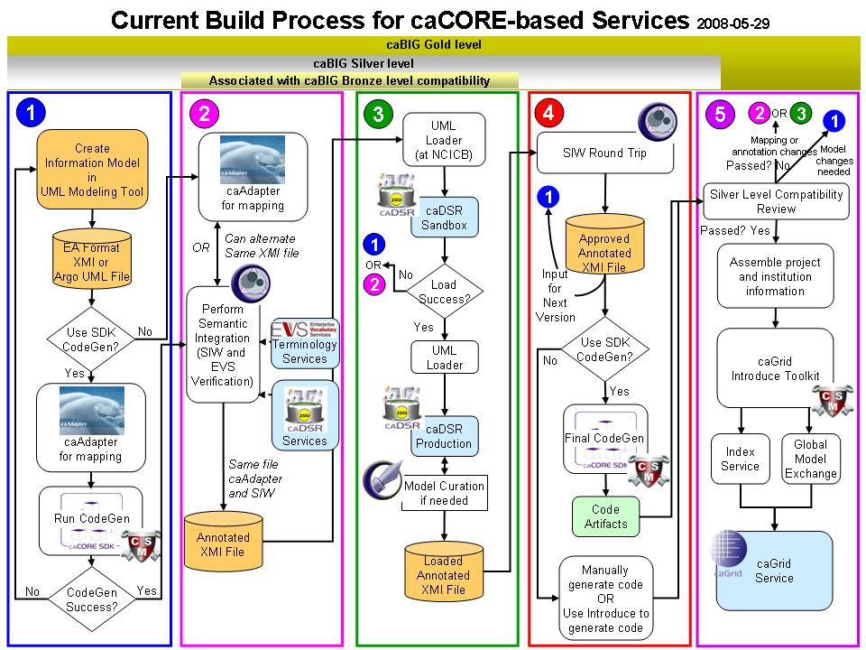






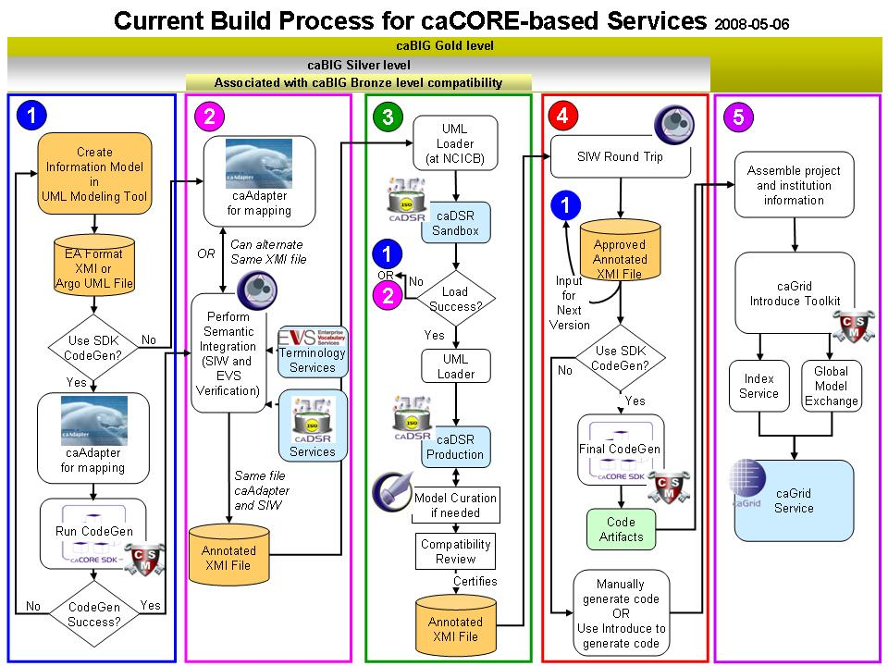
caCORE SDK 4.0 – A Framework to Develop Data Sharing Applications
Satish Patel¹, Dan Dumitru¹, Santosh Garmilla¹, Charles Griffin¹, Aynur Abdurazik², Avinash Shanbhag³, David Hau³, Denise Warzel³
¹ Ekagra Software Technologies • ² SAIC • ³ NCI CBIIT
Overview
caCORE Software Development Kit (caCORE SDK) is NCI CBIIT’s tool that generates a data management framework to allow researchers to navigate through a large number of data sources. The caCORE SDK generated system is built on the principles of Model Driven Architecture (MDA), n-tier architecture and common APIs which allows for easy access to data, particularly by other applications in a secured or non secured fashion. When the caCORE SDK generated system is combined with controlled vocabularies and registered metadata, the resulting software system, called “caCORE-like” system, is “semantically integrated”. All exposed API elements have runtime accessible metadata that defines the elements using controlled terminology.
SDK System Generation Process
Build UML object model using Enterprise Architect or ArgoUML
Build UML data model using Enterprise Architect or ArgoUML
Export UML model in XMI/XML format
Perform O/R mapping using caAdapter
Configure caCORE SDK code generator
Run the code generator
Deploy the generated application
Query the database against deployed application
SDK Generated Middleware System
UML Modeling Tool (EA/ ArgoUML)
Build UML Model
Export UML Model
caCORE SDK Middleware System
Use Generated Artifacts
Retrieve Data for User Query
Package Generated Artifacts with Runtime System
Generate Artifacts
Read UML Model
caCORE SDK Code Generation
Core Services
Registered in
Semantically described with terminology from
Registered in
Object
Definition
WSDL
XSD
SDK Service
Map to
Service Definition
Validate against
SDK Service API
SDK Client API
Grid Service
Generated by Introduce
Oracle
Database
Objects
Grid Client API
Java API
Client App
Reads
XML
Objects
MySQL
Database
Reads
Objects
Objects
Java API
Metadata Reuse
Create UML Model
Semantic Annotation
Transform UML Model into Metadata
SDK Code Generation
Compatibility Review
Create a Node on the Grid
WSDL
XSD
Client uses
Service Definition
Validate against
CSM
Security
Database
Checks
XML
Web Service
Client uses
HTTP/REST
Internet Browser
XML/ HTML
Roadmap
Freestyle search API
Graphical installer
HL7 data type support
Writable API support in web tier
.NET based implementation of SDK generated system
Code Generator Features
Supports ArgoUML and Enterprise Architect
Generates Java beans, Hibernate mapping files, cache configuration files, wsdd file, XSDs and Castor mapping files
Supports UML class diagram features including classes, associations, attributes, generalization etc
Allows user to specify primary key generators, cascade settings and other O/R mapping features at UML model
Generated System Features
Provides various interfaces to access data
Integrated security with CSM
QBE interface
Seamless integration with the cagrid tools
Upcoming SDK 4.1 Features
Writable API
Validator
Security
Integrated logging and auditing functionality
Enhanced O/R mapping
GME Namespace based XSD generation
Acknowledgement
CSM Team (Ekagra Software Technologies)
Vijay Parmar, Kunal Modi
caGrid Team (Ohio State University)
Scott Oster, David Ervine, Shannon Hastings
caAdapter Team (Scenpro)
Charles Yaghmore, Eugene Wang

